Slide 1
A Quantitative Review on
Language Model Efficiency Research
(Literature Mining)
Meng Jiang, Hy Dang, and Lingbo Tong
Department of Computer Science and Engineering
University of Notre Dame

Slide 2
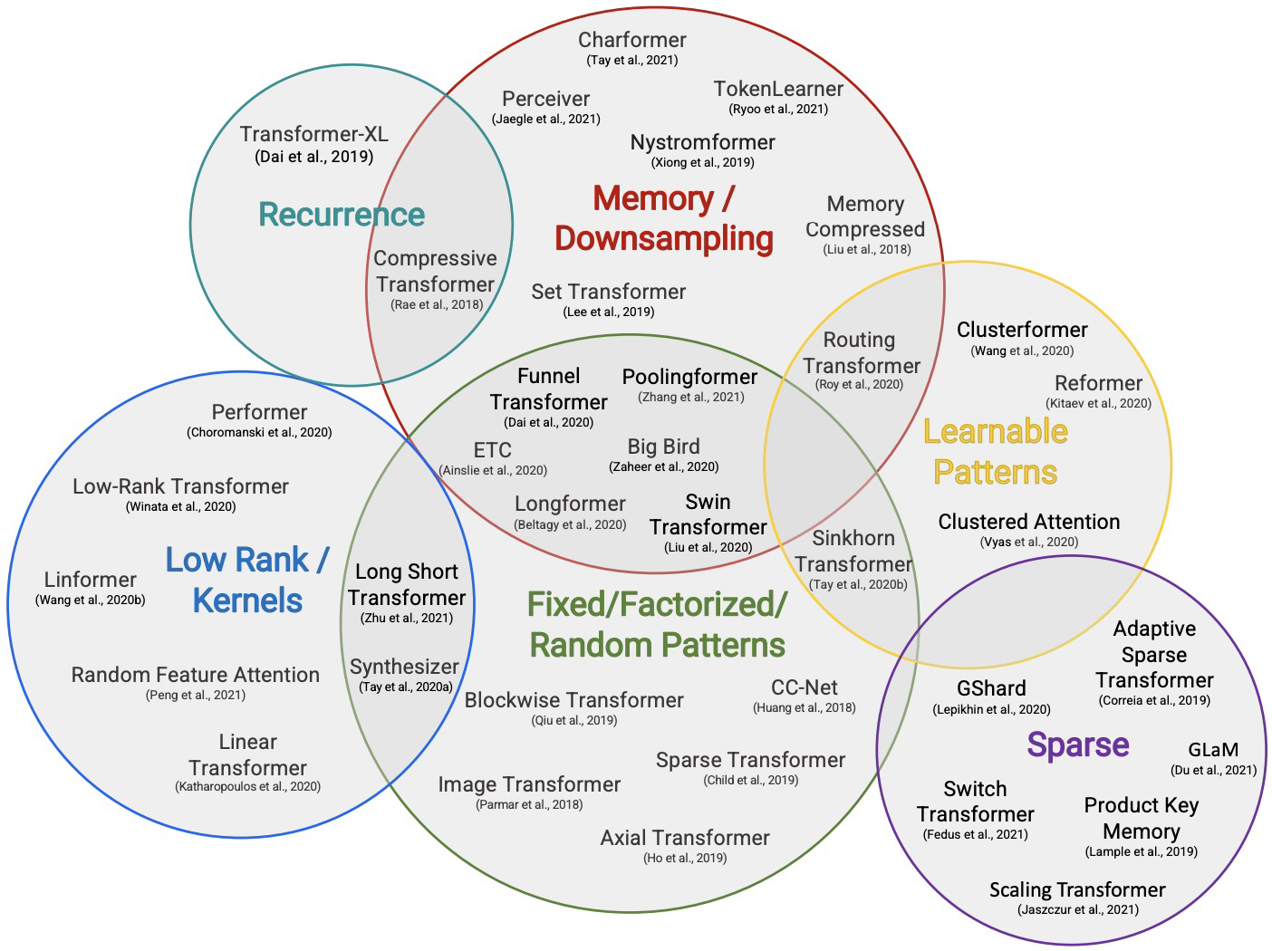
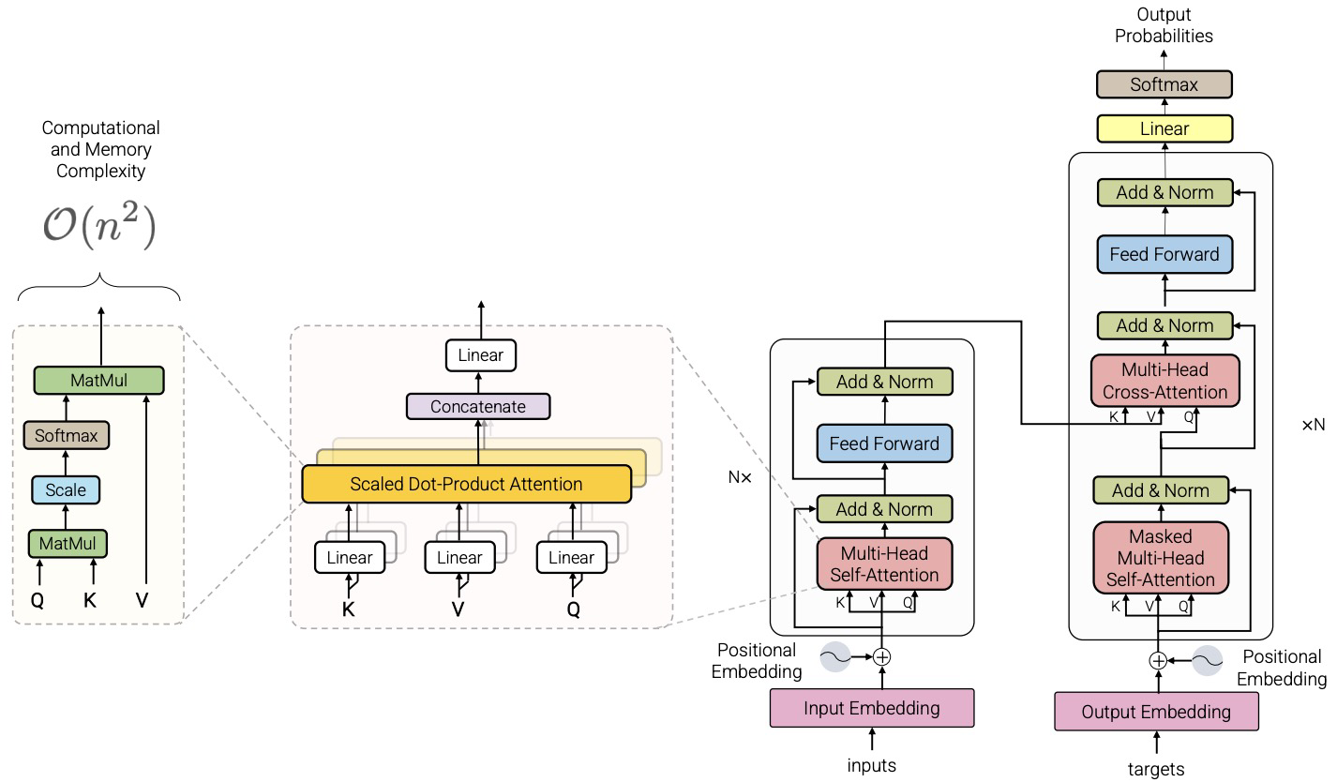
Efficient Transformers: A Survey (2022)
Yi Tay, Mostafa Dehghani, Dara Bahri, Donald Metzler
Section 2 Background: Introduced standard Transformer architecture.
Section 3 Survey of Models: Introduced a taxonomy of efficient architectures.
Section 4 Discussion: “On Evaluation”

Slide 3
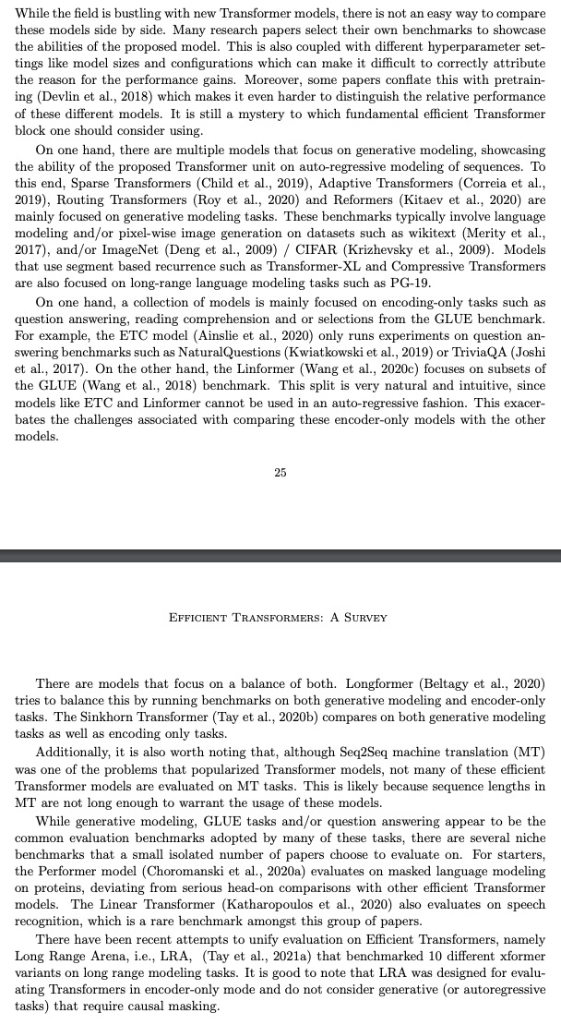
On Evaluation
in Efficient Transformers: A Survey (2022)
“Many research papers select their own benchmarks to showcase the abilities of the proposed model.”
“This is also coupled with different hyperparameter settings like model sizes and configurations which can make it difficult to correctly attribute the reason for the performance gains.”
“Moreover, some papers conflate this with pretraining which makes it even harder to distinguish the relative performance of these different models.”

Slide 4
Why Quantitative Review?
on Efficiency Research
It’s hard to get to know what model was empirically better than the others, but research cannot ignore it: we care what is good, better and the best.
Reviewing empirical results from multiple papers (instead of only one) can improve our understanding of the characteristics of models.
It can also inspire us to design better research methods.

Slide 5
Key Questions
in this Quantitative Review (and Reading Group Discussion)
What are the state-of-the-art efficient LMs?
Are the results reported and confirmed by multiple sources? Are there inconsistent results, i.e., significantly different reported performance of one LM reported by different sources?
Most studies wanted to claim that theirs were the best solutions when the papers were submitted or accepted. Are these claims correct?

Slide 6
Efficient Language Model Architectures
in this Review
Transformers
Sparse Transformer [Child et al. 2019]
Transformer-XL [Dai et al. 2019]
Reformer [Kitaev et al. 2020]
Longformer [Beltagy et al. 2020]
Linear Transformer [Wang et al. 2020]
SwitchTransformer [Fedus et al. 2022]
Charformer [Tay et al. 2022]
….
State Space Models (SSMs):
Linear State-Space Layer [Gu et al. 2021]
Diagonal State Space [Gupta et al. 2022]
S4: Structured State Space sequence model [Gu et al. 2022]
S5: Multi-input Multi-output SSMs [Smith et al. 2022]
….

Slide 7
Language Tasks, Datasets, Evaluation Metrics
 |  | Bits per character (BPC) ↓ | Perplexity ↓ | Accuracy ↑ | F1 ↑ | ROUGE-L ↑ | Matthew Correlation Coefficient (MCC) ↑ | Spearman’s rank correlation coefficient (SC-P/SC-S) ↑
Language modeling | enwik8
 | wikitext
Question answering | TriviaQA
 | NQ
Summarization | arXiv
GLUE (NLU/NLI) | CoLA
 | SST-2
 | MRPC
 | STS-B
 | QQP
 | MNLI
 | QNLI
 | RTE
Long-range arena (LRA) | ListOps
 | Text
 | Retrieval
 | Image
 | Pathfinder
Not evaluated on efficiency metrics
but effectiveness at a certain level of efficiency

Slide 8
Key Observations
from this Quantitative Review
Reducing time and/or memory complexity would inevitably sacrifice a bit non-efficiency performance like accuracy. When the complexities of a set of models were reduced to a certain level, one could claim that the model that achieved the highest accuracy would be the most efficient solution. Past empirical studies unanimously performed efficiency evaluation based on this hypothesis.
Comment: What are the pros and cons of this indirect evaluation method?

Slide 9
Let’s look at results on each task.

Slide 10
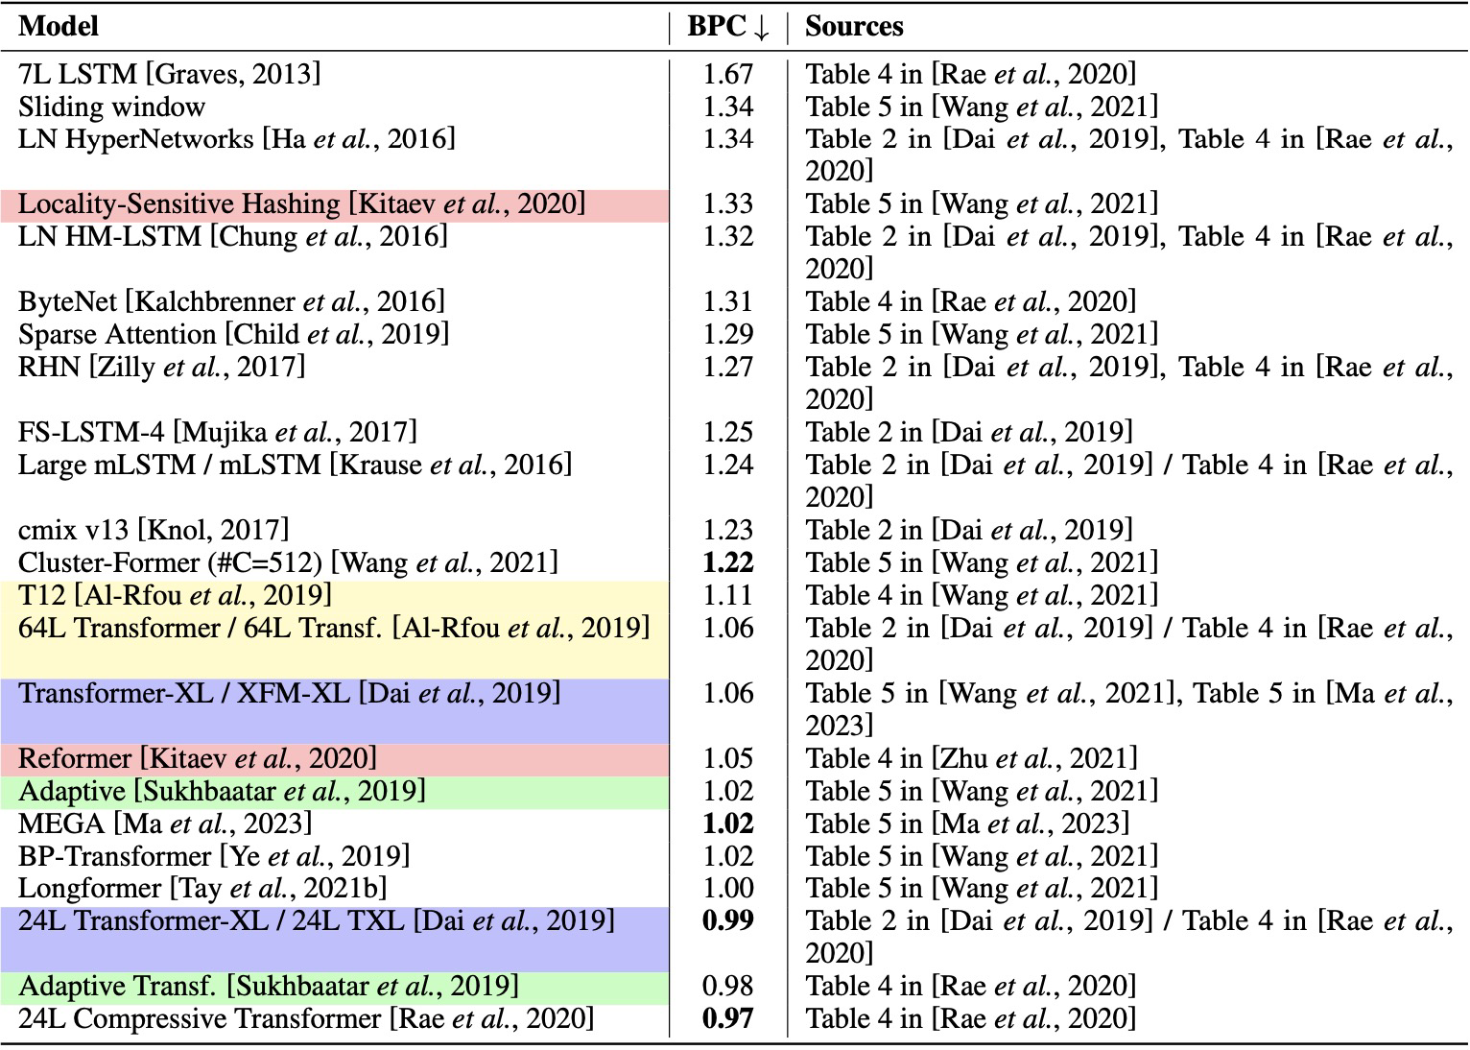
Language Modeling – enwik8
where the number comes from
multiple:
(a) either confirmed or re-used
the same name
different names
multiple:
(b) sets of inconsistent
reported numbers
“Compressive Transformer” was not in [Want et al. 2021]
Overall state-of-the-art
claimed as “state-of-the-art” (better than any baseline)

Slide 11
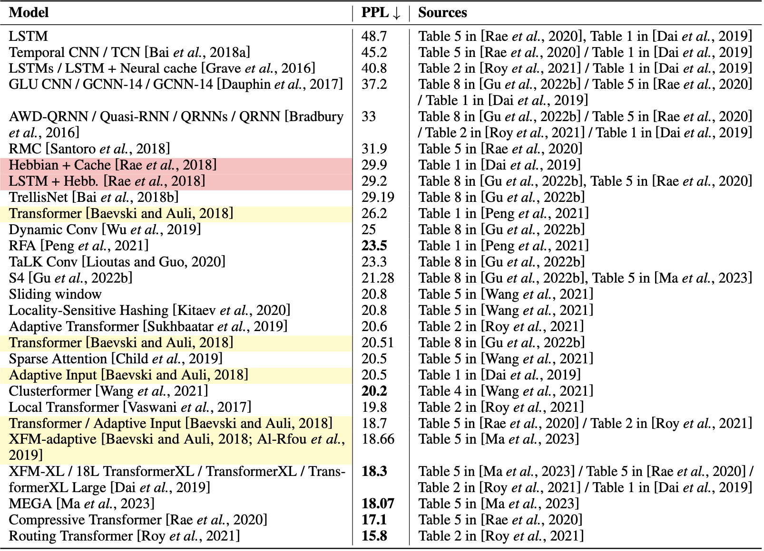
Language Modeling – wikitext

Slide 12
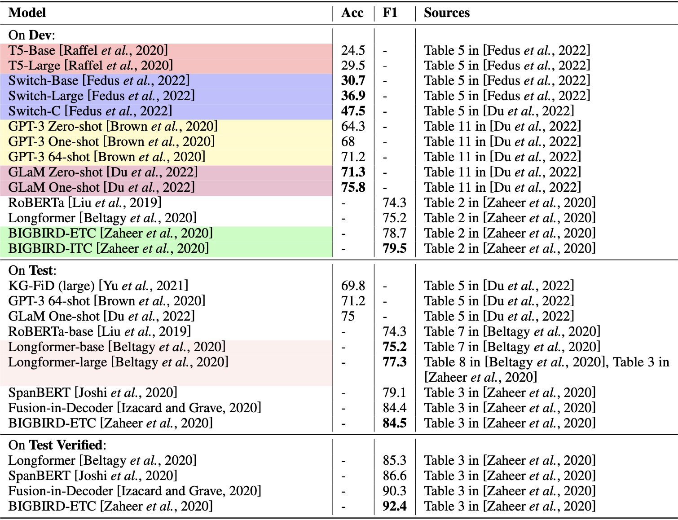
Question Answering– TriviaQA
includes 950K both human-verified and machine-generated reading comprehension question-answer pairs from 662K documents collected from Wikipedia and the web.

Slide 13
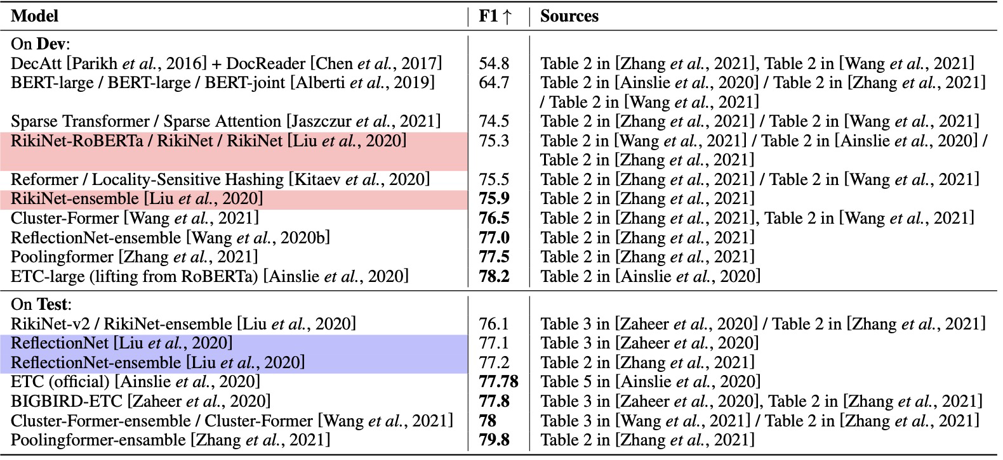
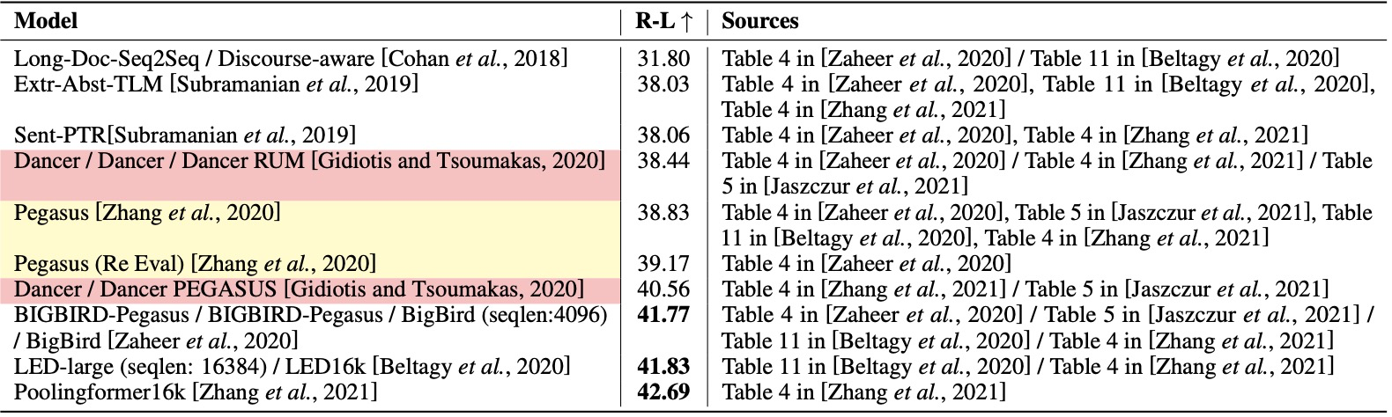
Question Answering– NQ
contains 307,373 training examples, 7,830 development examples, and 7,842 test examples.
Each example is comprised of a google.com query and a Wikipedia page.
Summarization – arXiv

Slide 14
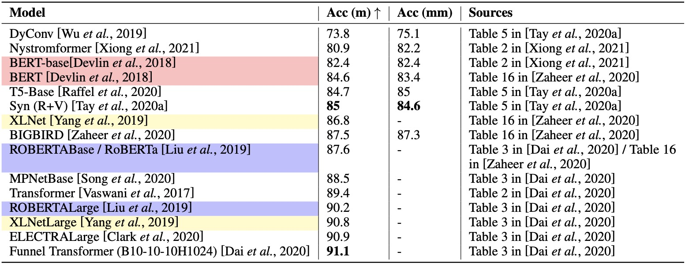
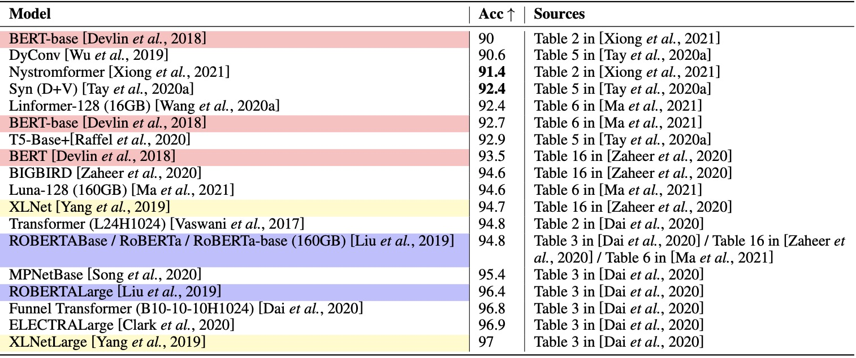
GLUE – MNLI (Multi-Genre Natural Language Inference)
GLUE – SST-2 (Stanford Sentiment Treebank)

Slide 15
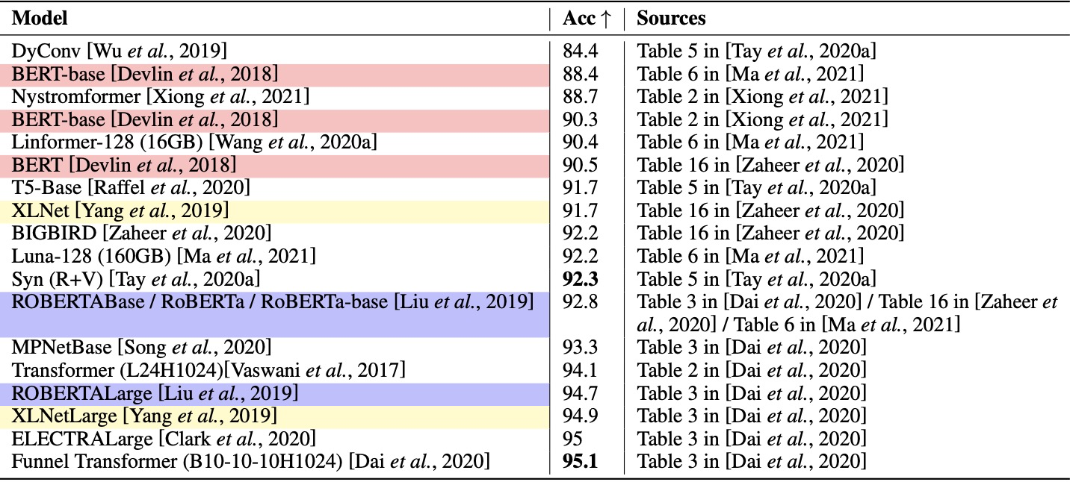
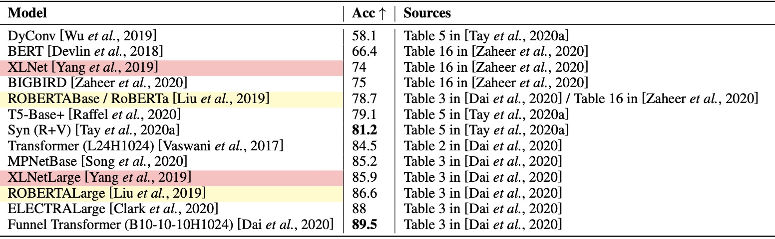
GLUE – QNLI (Question-answering Natural Language Inference)
GLUE – RTE (Recognizing Textual Entailment)

Slide 16
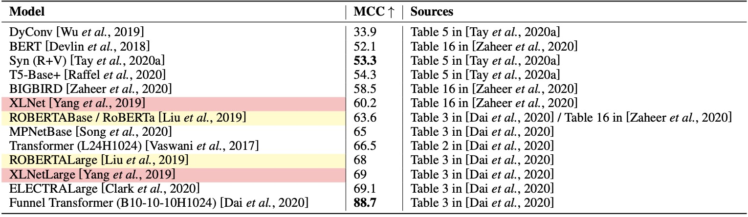
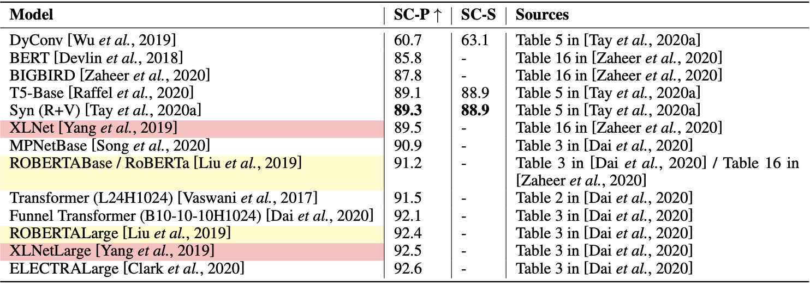
GLUE – COLA (Corpus of Linguistic Acceptability) MCC: Matthew Correlation Coefficient
GLUE – SST-B (Semantic Textual Similarity Benchmark)
SC: Spearman’s Correlation Coefficient

Slide 17
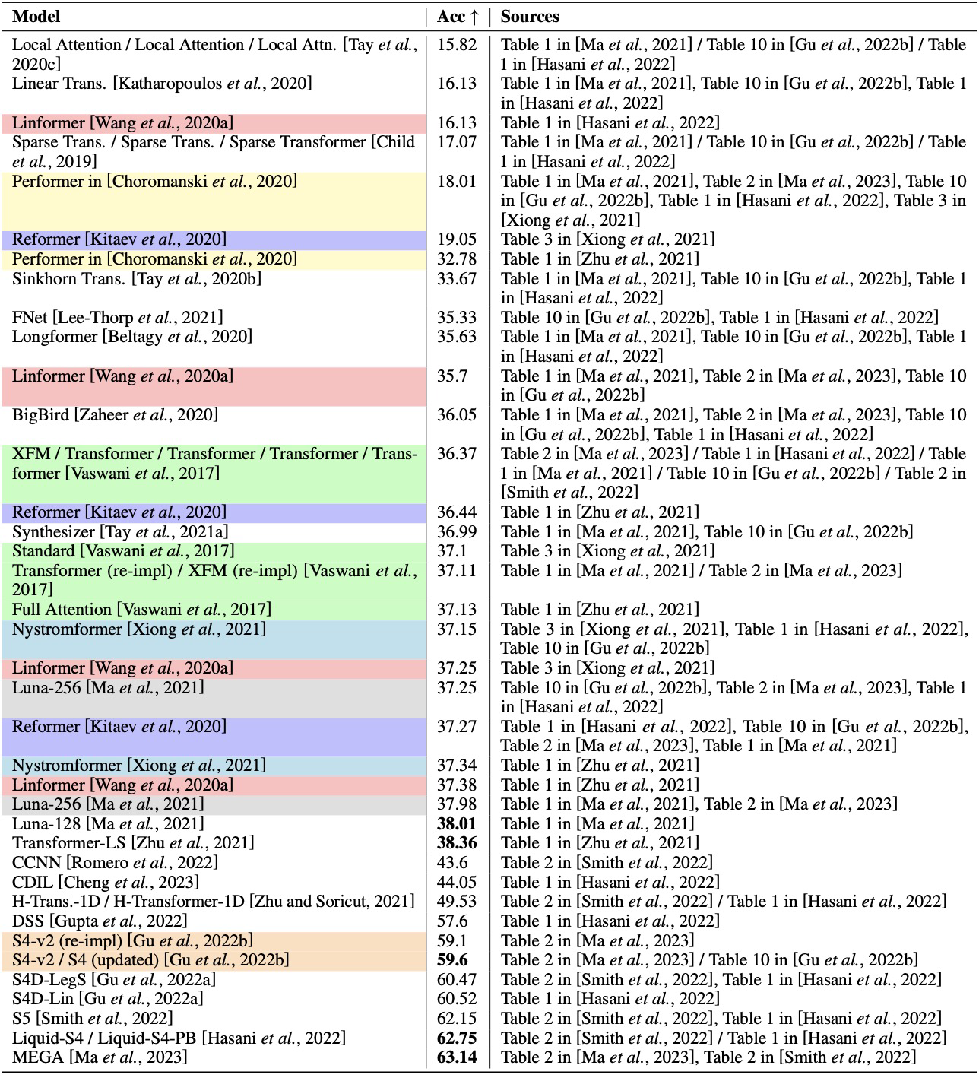
LRA – ListOps

Slide 18
LRA – ListOps (cont.)

Slide 19
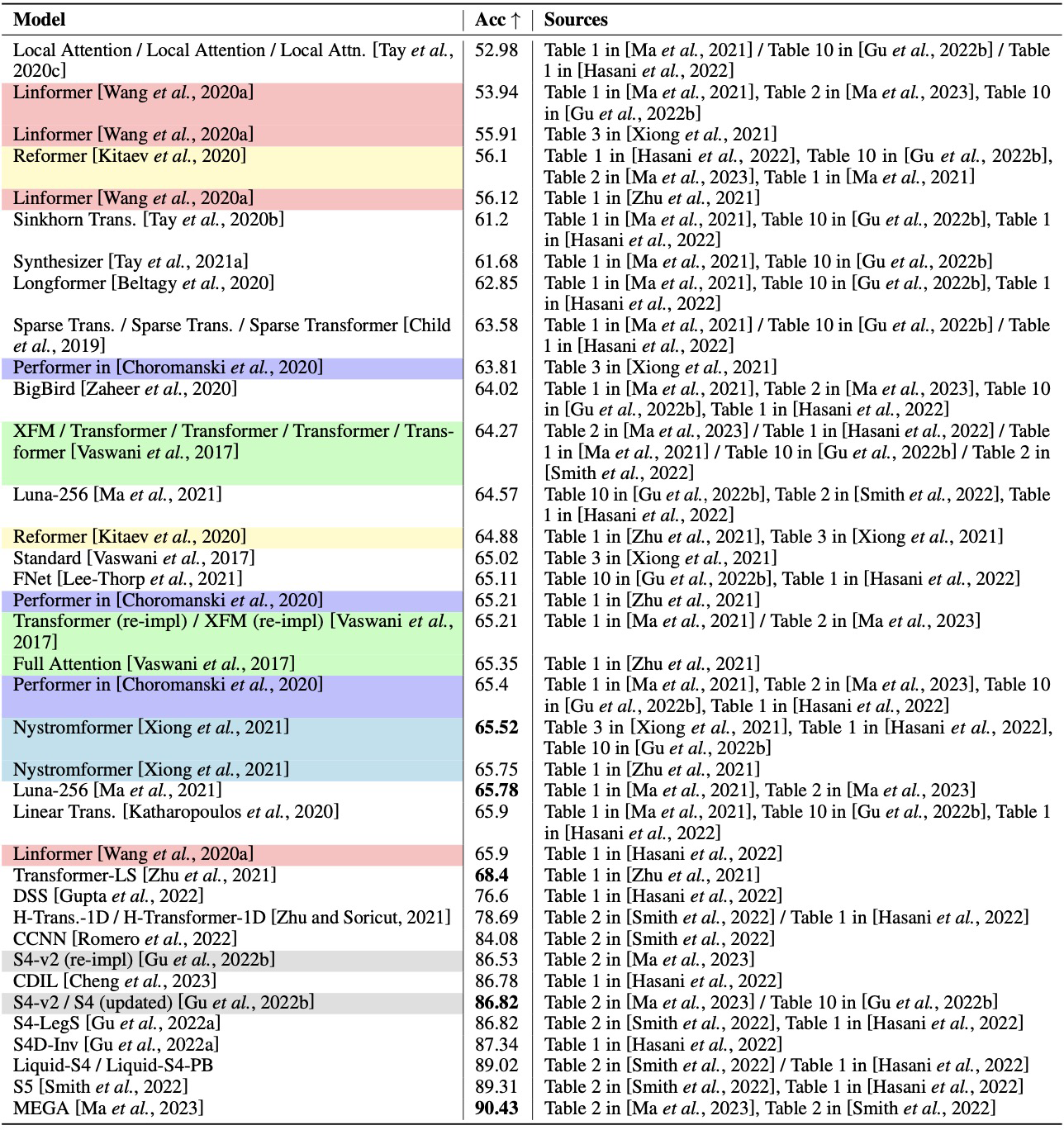
LRA – Text

Slide 20
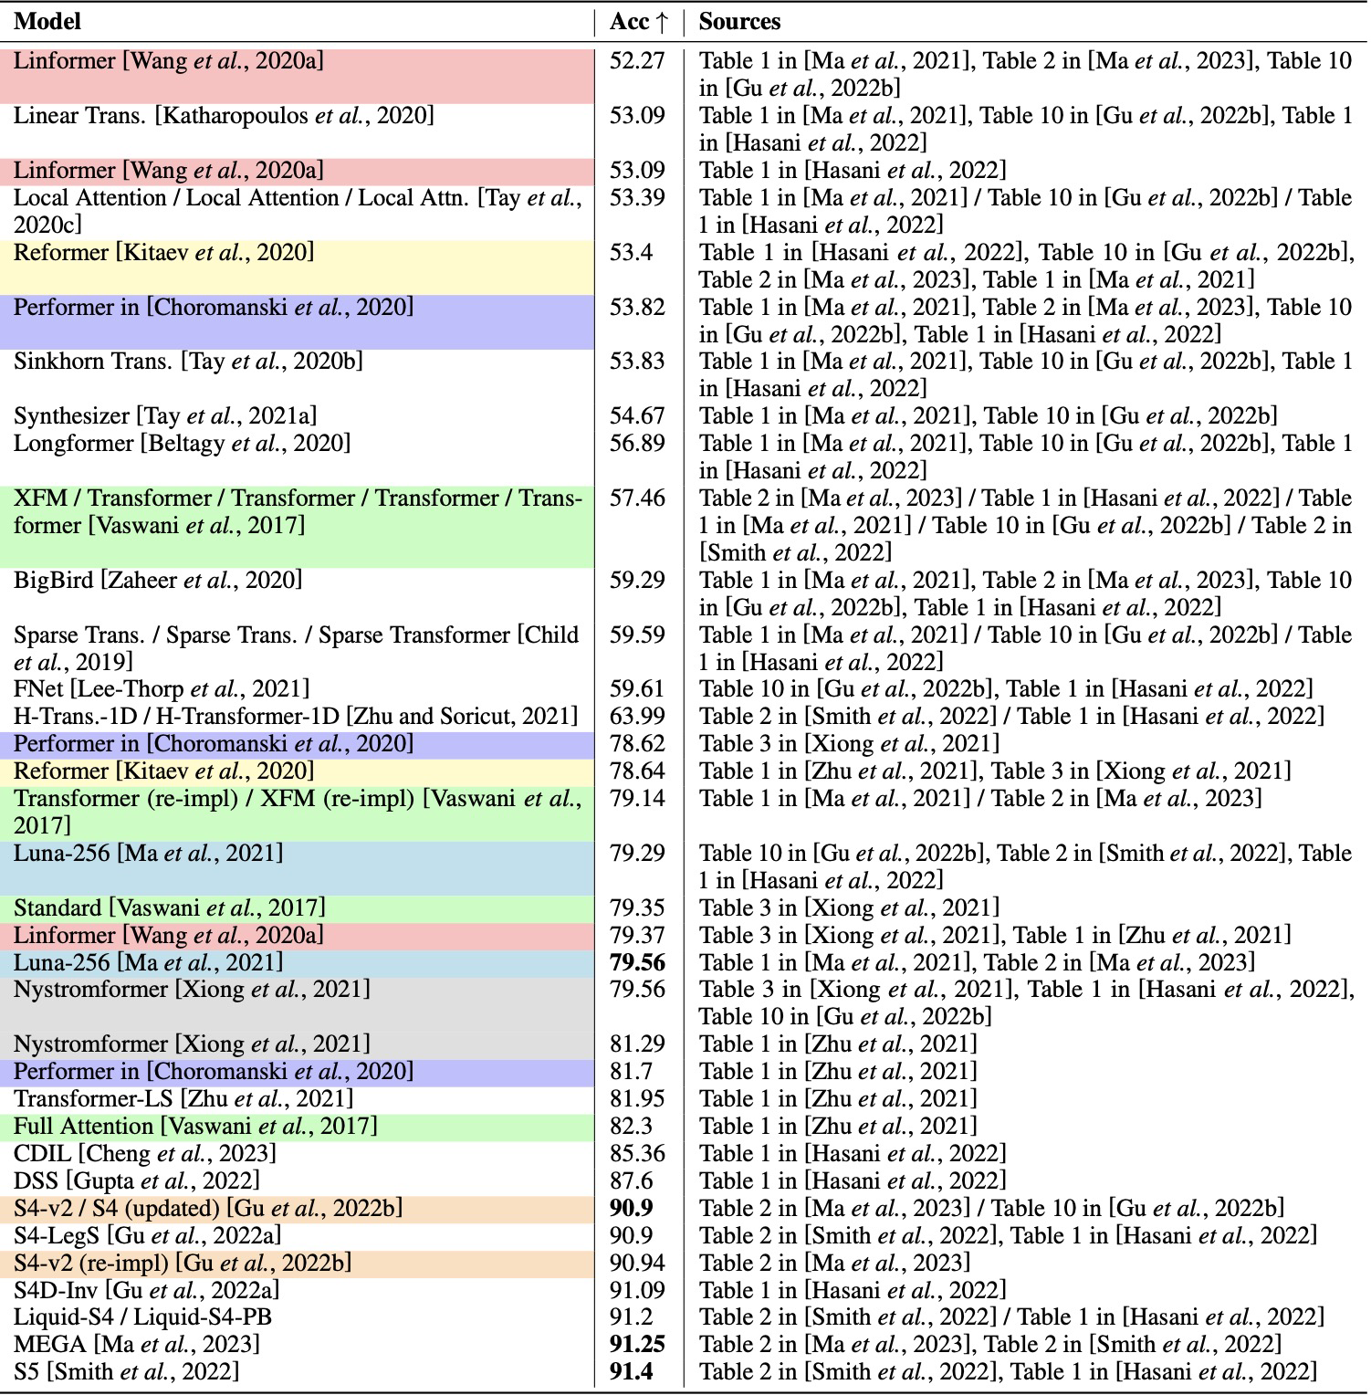
LRA – Retrieval

Slide 21
Let’s summarize our observations.

Slide 22
Key Observations
from this Quantitative Review
Reducing time and/or memory complexity would inevitably sacrifice a bit non-efficiency performance like accuracy. When the complexities of a set of models were reduced to a certain level, one could claim that the model that achieved the highest accuracy would be the most efficient solution. Past empirical studies unanimously performed efficiency evaluation based on this hypothesis.
Comment: Indirect evaluation and comparison might not be what we need. The real objective should be time and space complexity when the focus is model efficiency. Should we compare their marginal differences on accuracy-based performance when the complexity of the models was not reported or analyzed?

Slide 23
Key Observations (cont.)
from this Quantitative Review
Most empirical studies compared their proposed model against others on multiple tasks, and usually claimed theirs is the best one on all of them. However, our review identifies different winning approaches for different tasks and even different datasets. It fixes the one-sided understanding that researchers would have from learning only one or a few empirical studies.
More than half of the results were reported by at least two sources. However, it is impossible to tell from the papers whether the numbers were reproduced/confirmed or just re-used from previous work. Inconsistent results were found on almost every task, caused by various settings of hyperparameters (e.g., model sizes, configurations) and reproductions.

Slide 24
Conclusions
from this Quantitative Review
This literature review on LM efficiency offered a set of integrated comparative results that would not be observed without such an effort. It covered both Transformer models and the emergent state space models.
Researchers are suggested to report the performance of baselines properly, write clearly if the numbers in experimental results were re-used from prior work or reproduced, and report and analyze any inconsistent results that are identified compared with related studies.
Researchers in this field need public leaderboards. We need to think about evaluation metrics for the leaderboards.

Slide 25
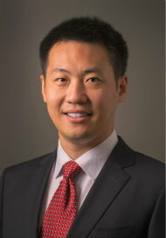



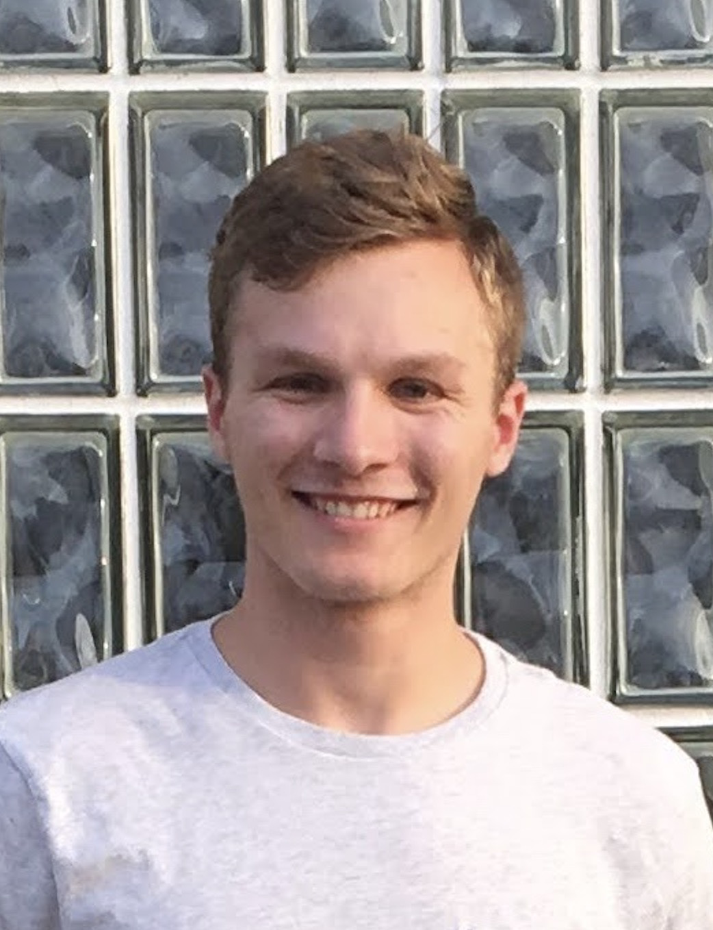








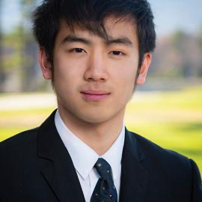
Meng Jiang
Associate Professor
Wenhao Yu
Bloomberg Fellowship
ICLR’23, EMNLP’22 * 2, ACL’22 * 2,
EMNLP’21 * 2, NAACL’21, WWW’20 * 2
LLM and open-domain QA
Qingkai Zeng
KDD’21, EMNLP’20
Information Extraction
Taxonomy Construction
Faculty
PhD Cand.
Zhihan Zhang
TACL’23, EMNLP’22
LLM and open-domain QA
Instruction Tuning
Noah Ziems
ACL’23
LLM and open-domain QA
Controlled Text Generation
Mengxia Yu
CSE Select Fellowship
LLM for Education
Comparative Reasoning
PhD Student
Lingbo Tong
Psychology-CSE Joint PhD
LLM for Mental Health
Knowledge Graph
Hy Dang
LLM for Mental Health
Query Expansion
Bang Nguyen
LLM for Education
Query/Question Generation
Zhaoxuan Tan
LLM for User Profiling
Mengzhao Jia
LLM for User Profiling
Eric Inae
Dean’s Fellowship
Zheyuan Liu
Gang Liu
KDD’22
KDD’23 GNN for Material Science

Slide 26

Welcome to visit our lab!
http://www.meng-jiang.com/lab.html
https://github.com/DM2-ND
mjiang2@nd.edu
26

